Slide 1
2023 National Park Service Region 11 - Alaska

Slide 2
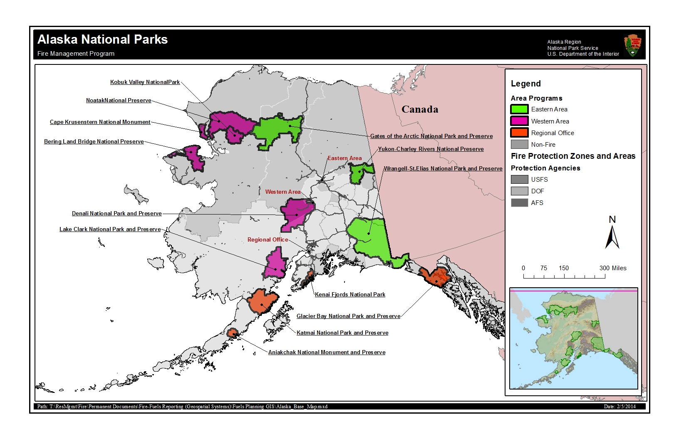

Slide 3
NPS Organizational Chart (abbreviated)
Chuck Russell
Alaska Regional Fire Management Officer
Jason Devcich
Eastern Area Fire Management Officer
Amy Carr
Eastern Area Fire Program Management Assistant
Susanna Nancarrow
Regional Fire Budget Analyst
Jennifer Barnes
Regional Fire Ecologist
Larry Weddle
Deputy Regional Fire Management Officer
Jennifer McMillan
Assistant Regional Fire Ecologist
Brian Sorbel
Regional Fire GIS
Caron McKee
Regional Communication & Education Specialist
Keith Mitchell
Acting Western Area Fire Management Officer
Carrie Skinner
Western Area Fire Program Management Assistant
Heidi Strader
Eric Steven
Fire Weather
In the process of being hired
Regional Fire Planner

Slide 4
NPS Notes
All resources assigned to an incident will follow incident agency requirements when staying at incident base or other location. Individuals are not automatically entitled to claim lodging or M&IE. An individual assigned to an incident where sleeping arrangements and meals are provided must have written authorization with justification from the Agency Administrator to obtain lodging and claim meals. (If not on RO)
The NPS Hiring Guide for 2023 has been updated.
A National Park Service incident business guide is being worked on. It will hopefully be done next spring.
DOI AD Pay Plan: The wording limiting AD hiring to 24 hours before and after a prescribed burn has been removed. The DOI Directors are aware of the discussion to remove the 300 hour limitation on RX fires, but no decision has been made.
NPS Fire vendor payments and cooperator bills should be sent to: NIFC_Suppression_Invoices@nps.gov
Creating Avenues of Success for Women in Wildland Fire Management Workshop next week in Waterloo, NY, with a site visit and tour of the Women’s Rights National Historical Park.

